Slide 1
Databanksysteem

Slide 2

Databanksysteem
Componenten
Hardware
Data
Software
Gebruikers

Slide 3
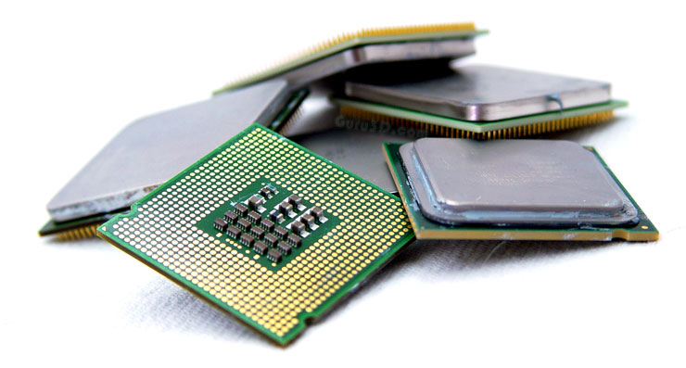
Databanksysteem
Hardware
Processoren
Hardware

Slide 4
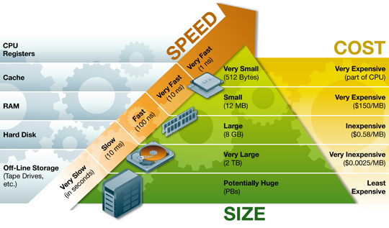
Databanksysteem
Hardware
Geheugen

Slide 5
Databanksysteem
Hardware
Geheugen
CPU
primair geheugen
databankbuffers
datastromen
secundair geheugen
databanken

Slide 6
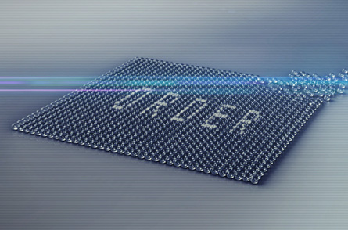
Databanksysteem
Data
Data
Gestructureerd
Geïntegreerd

Slide 7
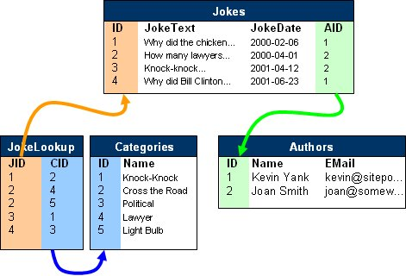

Databanksysteem
Data
Jokes
JokeText JokeDate CategoryName Name Email
Why did the chicken… 2000-02-06 Cross the Road Kevin Yank kevin@sitepo...
How many lawyers… 2000-04-01 Lawyer Joan Smith joan@somew...
How many lawyers… 2000-04-01 Light Bulb Joan Smith joan@somew...
Knock-knock… 2001-04-12 Knock-Knock Joan Smith joan@somew...
Why did Bill Clinton… 2001-06-23 Political Kevin Yank kevin@sitepo...
vs.

Slide 8










Databanksysteem
Software
DBMS
Software

Slide 9



Databanksysteem
Software
Overige
Beheer
Communicatie
Analyse

Slide 10
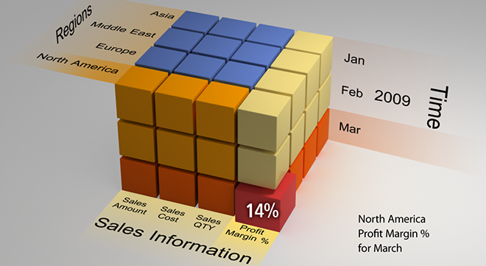
Databanksysteem
Software
Overige
Data warehouse

Slide 11
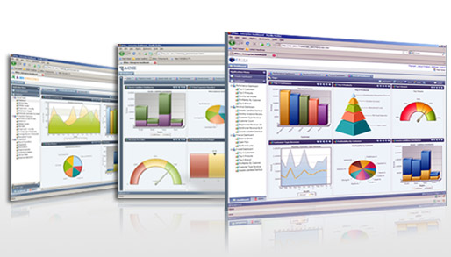
Databanksysteem
Software
Overige
Dashboard

Slide 12

Databanksysteem
Gebruikers
Gebruikers

Slide 13
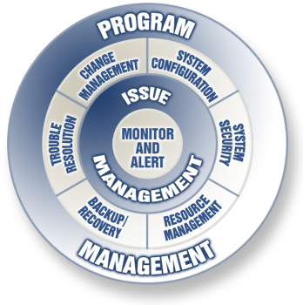
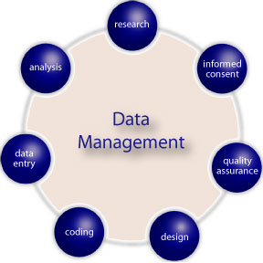
Databanksysteem
Gebruikers
DBA vs DA
DA
DBA

